Slide 1
MapReduce calculation of π
@Zoran B. Djordjevic

Slide 2
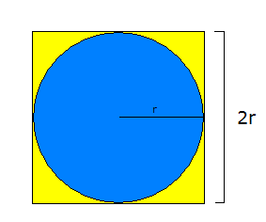
One More Candidate for Parallel Processing
As an example of the Map Reduce technique, consider one of the methods for approximate calculation of number π(pi).
The first step is to inscribe a circle of radius r inside a square of side 2r:
The area of the square, denoted by A_{s}, is equal to (2r)² or 4r².
The area of the circle, denoted by A_{c}, is equal to πr².
Combining those two expressions, value of π can be expressed as:
π = 4 * A_{c}/A_{s} = 4*(πr²/ 4r²)
@Zoran B. Djordjevic

Slide 3
Determining value of number π
We can parallelize this method in the following way.
Let the Master start several Mappers.
Let each Mapper randomly generate points inside a square and record the number of generated points and the number of points that fall inside the circle.
After a while, let every Mapper submit the number of points that fell inside the square and the number of points that fell inside its circle to the Reducer.
Let the Reducer sum all the numbers for circles and separately sum all the numbers for squares.
Reducer calculates the ratio of the numbers of points in all circles and the number of points in all squares
      π = 4 * (∑N_{ci}/∑N_{si})
@Zoran B. Djordjevic

Slide 4
Pseudo Code for Approximating π(pi)
NUMPOINTS = 100000; // some large number
//the bigger, the better
nw = number of MapperS;
numPerMapper = NUMPOINTS/nw;
countCircle = 0; // one of these for each Mapper
// each Mapper does the following:
for (i = 0; i < numPerMapper; i++) {
generate 2 random numbers that lie inside the square;
xcoord = first random number;
ycoord = second random number;
if (xcoord, ycoord) lies inside the circle
countCircle++;
}
REDUCER:
receives from Mappers their countCircles values
countCircles = sum all countCircle
// computes PI
PI = 4.0 * countCircles/NUMPOINTS;
@Zoran B. Djordjevic

Slide 5
Homework Assignment
Now that you know how to calculate the value of π,devise a parallel program to determine the value of number e
(Hint: π and e are related. -1 = e ^{i π} )
@Zoran B. Djordjevic

